Slide 1





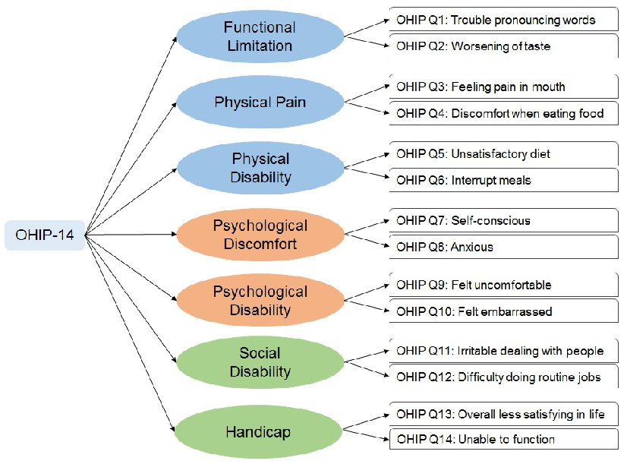




Assessing Oral Health Needs and Oral Health-Related Quality of Life in Individuals with Substance Use Disorders
Vanessa C. Mareno, DDS, MPH¹; Tiffany Lu, MD, MS^{1,2}; Parth Shah, DDS, MPH¹; Maryann Popiel, MD^{1,2}; Nadia Laniado, DDS, MPH, MS^{1,2}
¹New York City Health + Hospitals | Jacobi Medical Center, ²Albert Einstein College of Medicine
Introduction
Results
People with substance use disorders (SUDs) have high rates of tooth decay and gum disease, yet are nearly 50% less likely to receive dental care than the general population. Comprehensive dental care has been shown to improve oral health related quality of life (OHRQoL) as well as SUD treatment retention and psychosocial function. Hospital settings present a unique opportunity to address oral health and improve SUD treatment outcomes. The objectives of this study were to assess the oral health and OHRQoL among patients in Jacobi Medical Center’s Comprehensive Addiction Treatment Center (CATC) in the Bronx, New York.
Clinical characteristics of sample (N=137) | N | %
Periodontal conditions | 123 | 90
Missing teeth | 93 | 68
Obvious tooth decay | 86 | 63
Discussion
Integration of health services provides an opportunity for interprofessional collaboration guided by a common risk factor approach. Targeting modifiable risk factors can decrease the morbidity associated with chronic disease. The provision of oral healthcare leads to improvements in self-esteem, employability, and overall quality of life. Ongoing studies address oral health literacy and optimizing strong, reliable internal referral networks with satellite sites.
Methods
75% of referred patients
received a complete dental examination
Between January to June 2025, residents offered oral health screenings to individuals seeking outpatient SUD care in Jacobi’s CATC
Adults were recruited through convenience sampling (group sessions, scheduled visits, staff referrals, walk-ins)
Tools utilized: Oral Health Impact Profile 14 (OHIP-14) Questionnaire, CATC Oral Health Screening Form
Statistical analysis: Descriptive statistics
Conclusion
Poor oral health is highly prevalent among individuals with SUDs. These findings may help inform feasible oral health delivery models that can be integrated into comprehensive addiction care frameworks.
Outcomes:
1. OHIP-14 scores [Range from 0-4];
Higher score = greater negative impact
2. Clinical characteristics
References
Referral Pathways:
1. Referred to 1 of 5 dental clinics for comprehensive dental care
2. Triaged to on site dental clinic for same day emergency care

