Slide 1
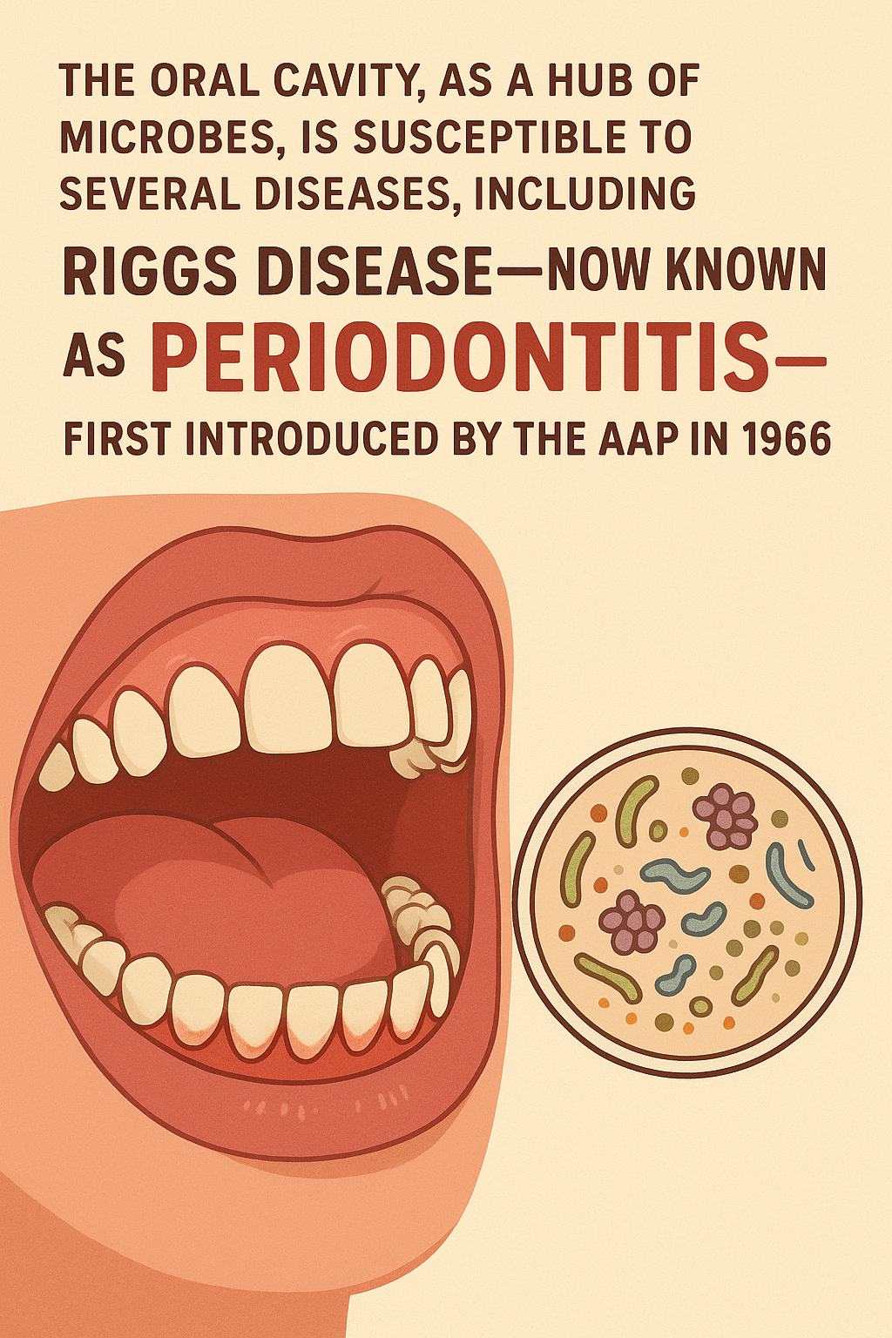
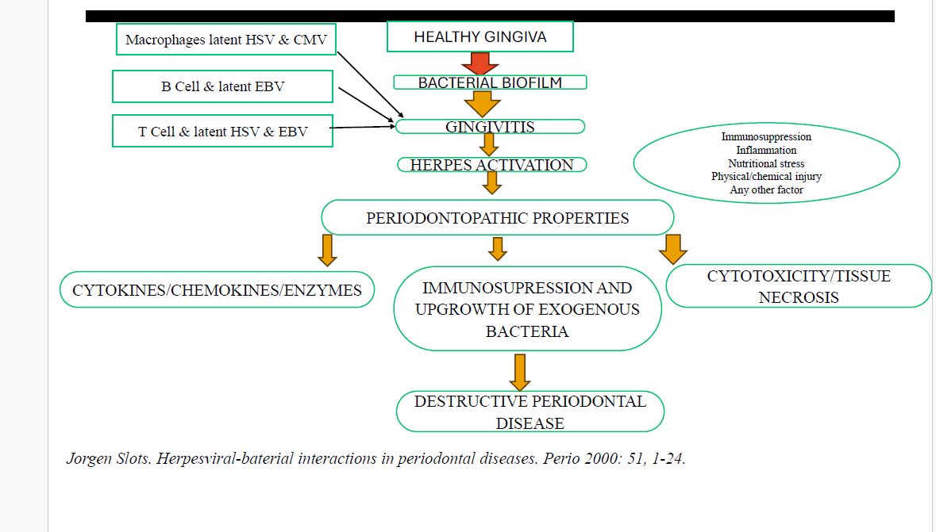

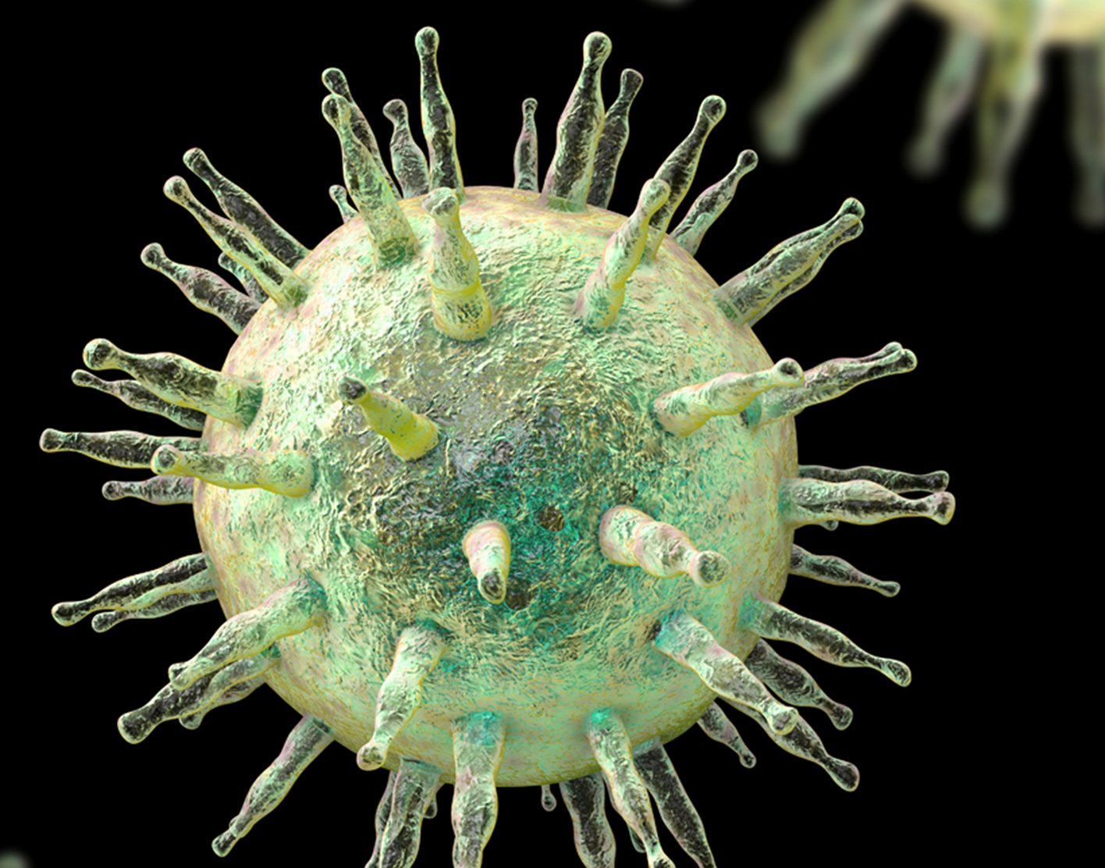
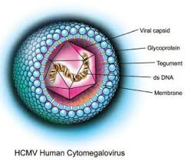
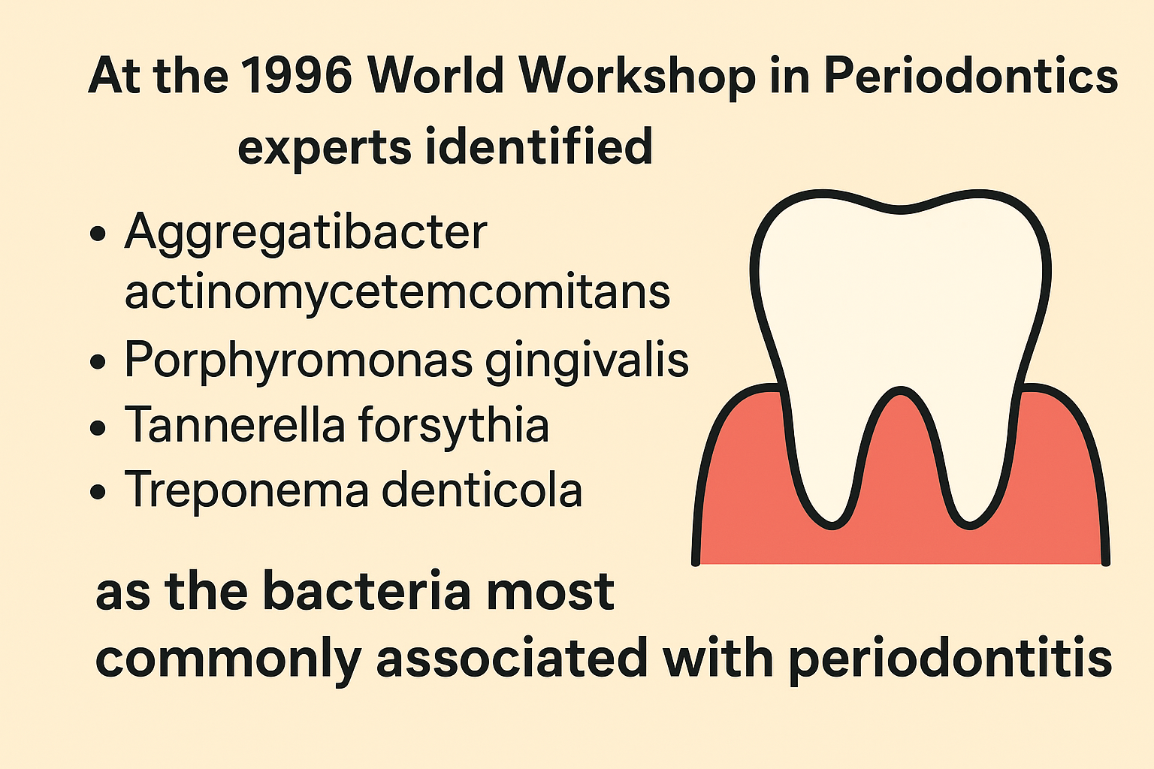
Viruses as Pivotal Contributors to Periodontal Disease Progression
 | STUDIES | MECHANISM/DISCUSSION
INTRODUCTION
DISEASE TYPE | VIRUS | KEY STUDY
Aggressive periodontitis |  | Ting et al
Chronic periodontitis |  | Wu et al
Periodontal abscess |  | Saygun J
Immunocompromised |  | Sculley TB
REFERENCES
• 1) Koonin EV, Senkevich TG, Dolja VV. The ancient Virus World and evolution of cells. Biology Direct. 2006;1:29.
• 2) Shklar, G; Carranza, FA: The Historical Background of Periodontology. In Newman, MG; Takei, HH; Carrana FA,
editors: Carranza’s Clinical Periodontology, 9th Edition. Philadelphia: W.B. Saunders Company, 2002. page 7.
• 3) M. G. Newman, H. Takei, P. R. Klokkevold, and F. A. Carranza, Caranza,s Clinical Periodontology, Elsevier, 10th
edition, 2006.
• 4) Nora silva et al. Host response mechanisms in periodontal diseases. J Appl Oral Sci. 2015 May-Jun; 23(3): 329–355.
•
VIRUSES ARE NOT MERELY BYSTANDERS BUT ACTIVE PARTICIPANTS IN PERIODONTAL DESTRUCTION

